Slide 1
Analysis of CTD Data
Larval Survey v HSC Data

Slide 2
Spatial and Temporal bounding for comparison

Slide 3
Comparing data collected by different sampling methods
CTD
BO (Bottle)
MB (MBT)
XB (XBT)

Slide 4
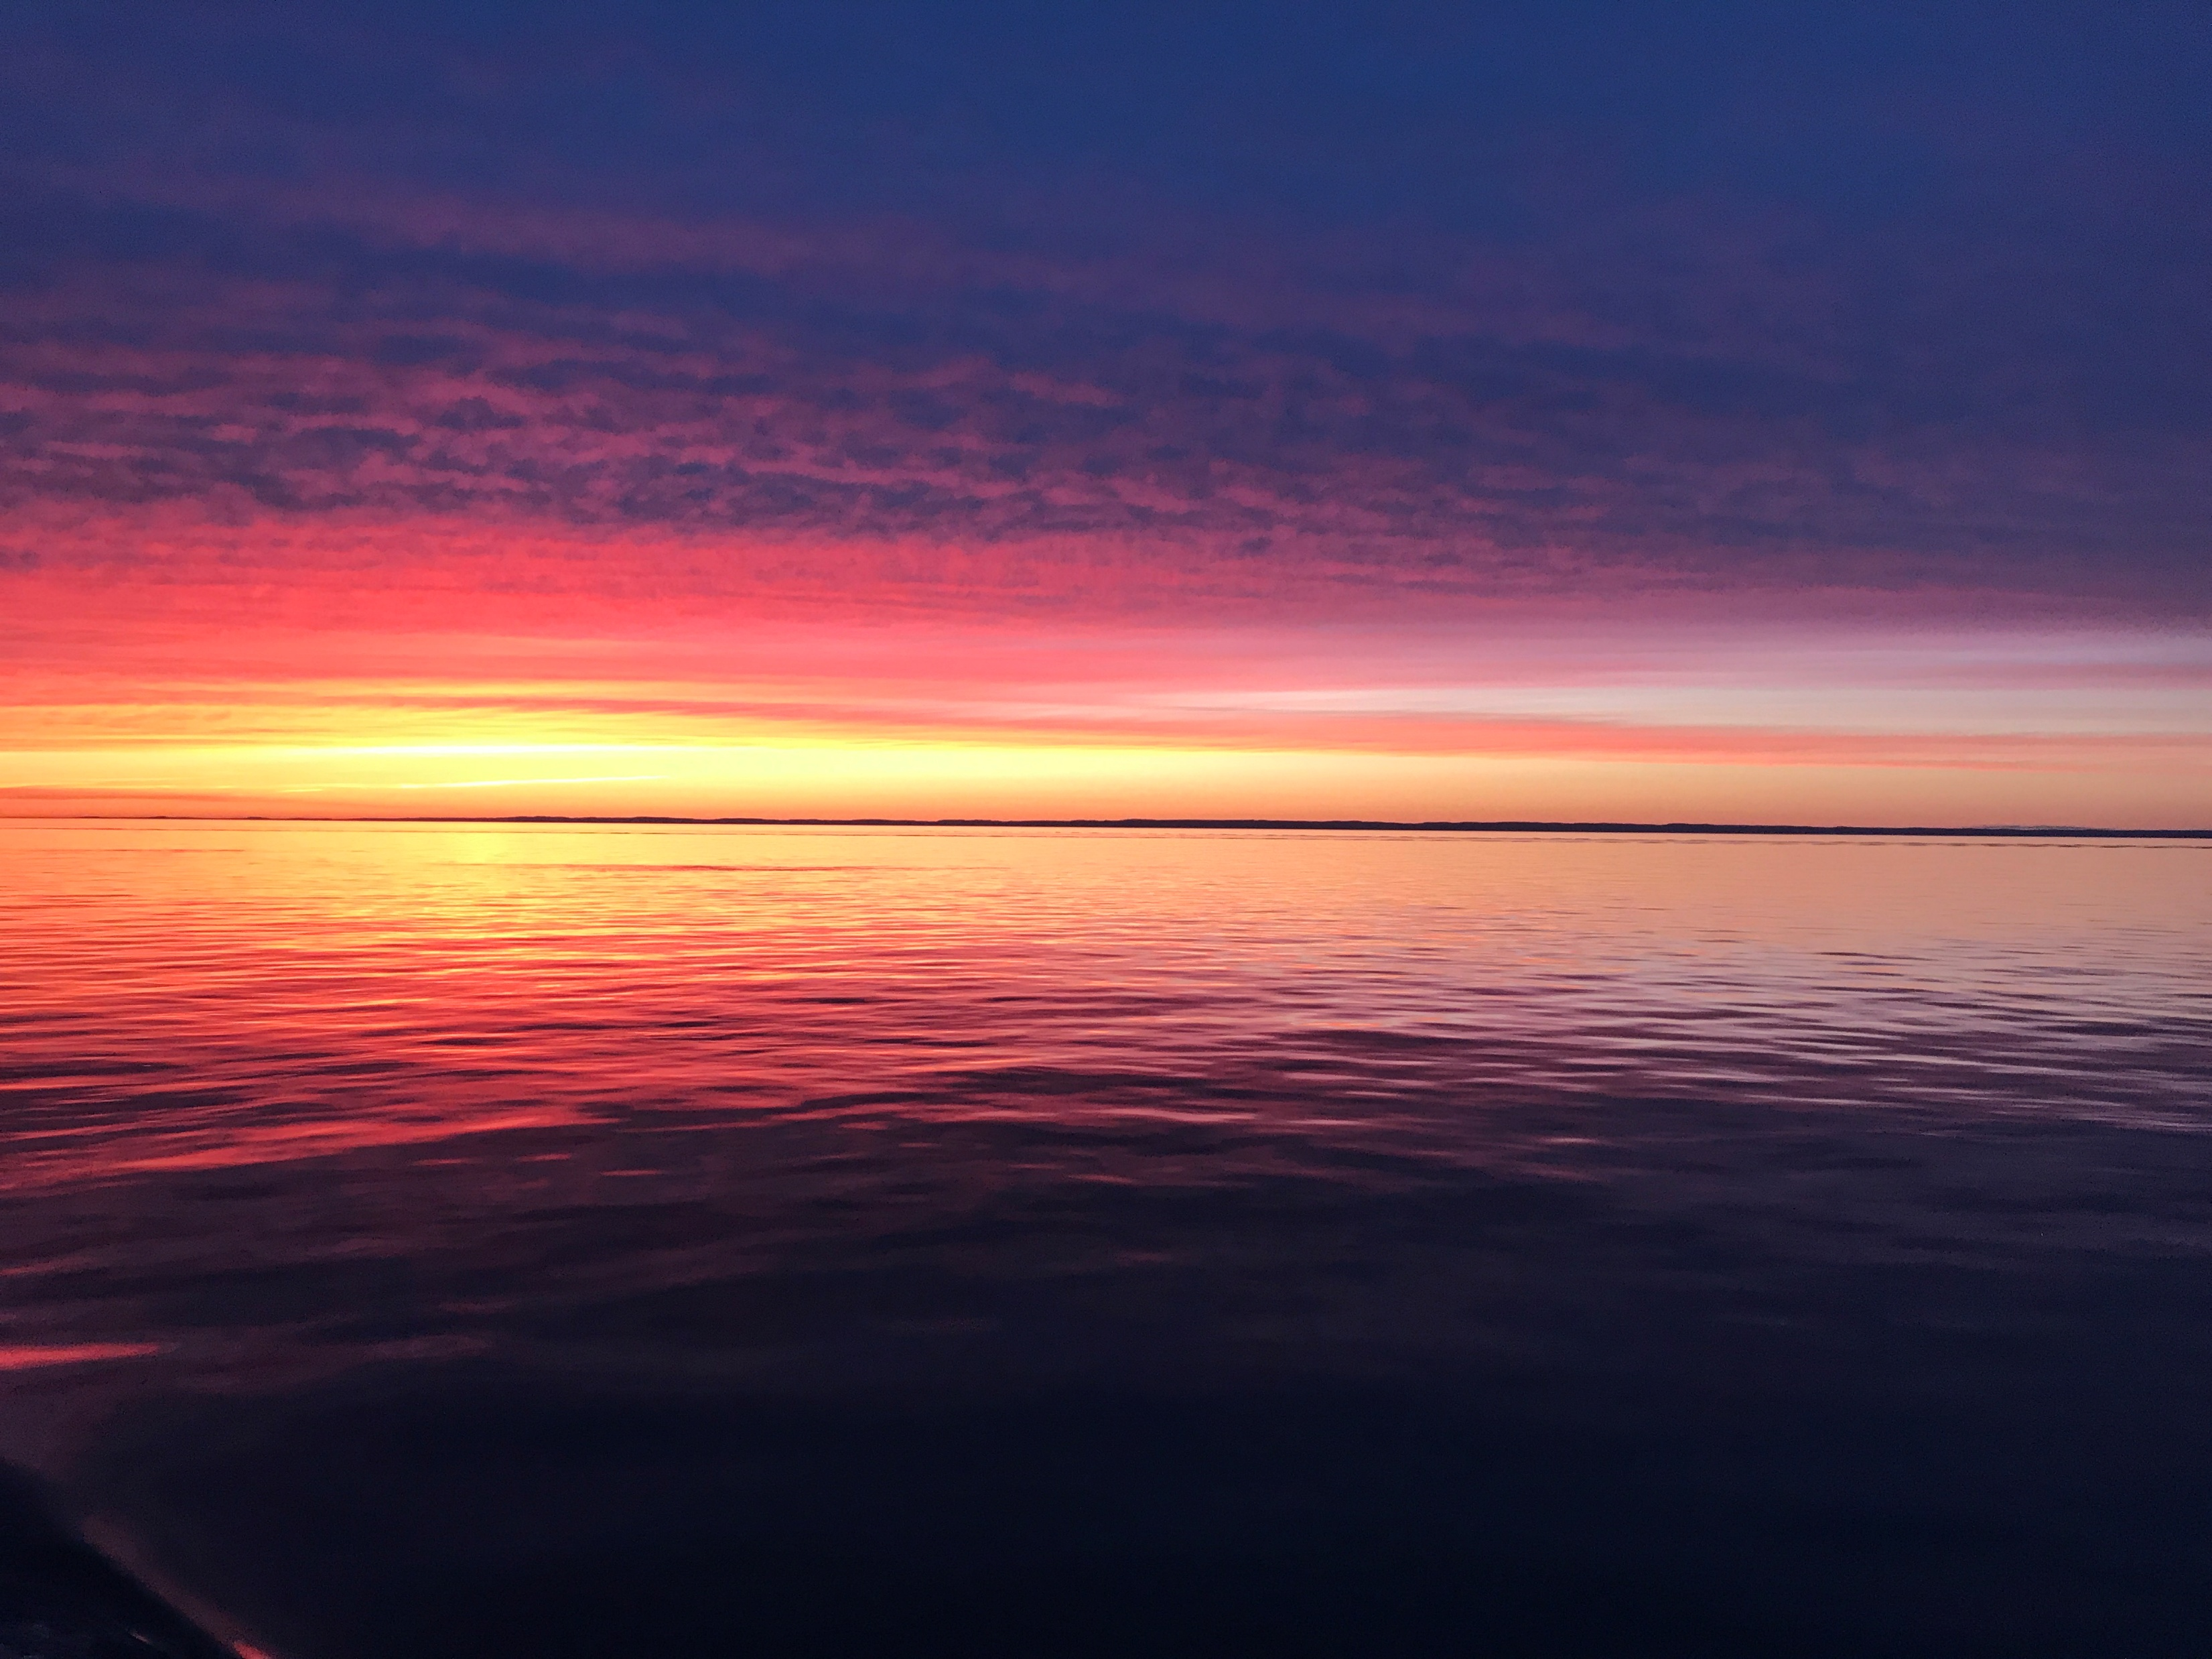
Oceanographic Data on Herring Major Spawning Grounds in SWNS/BoF

Slide 5
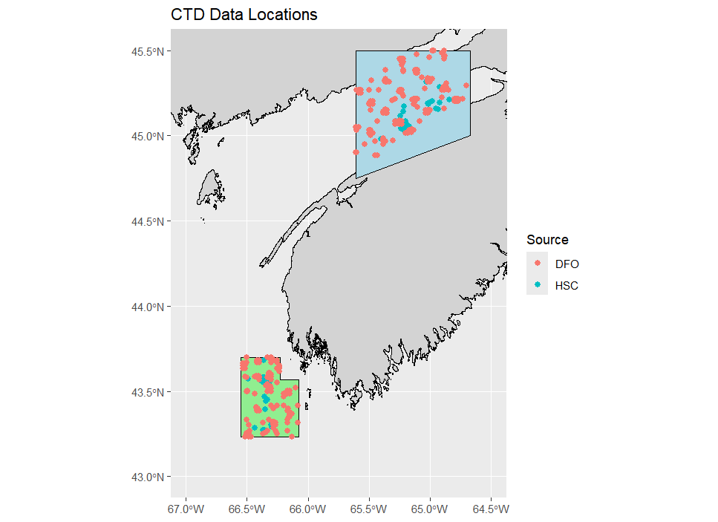
Suggested Spatial Bounding
5,118 km squared
-Really less as land is included, can work on polygon more if necessary?
1,806 km squared

Slide 6
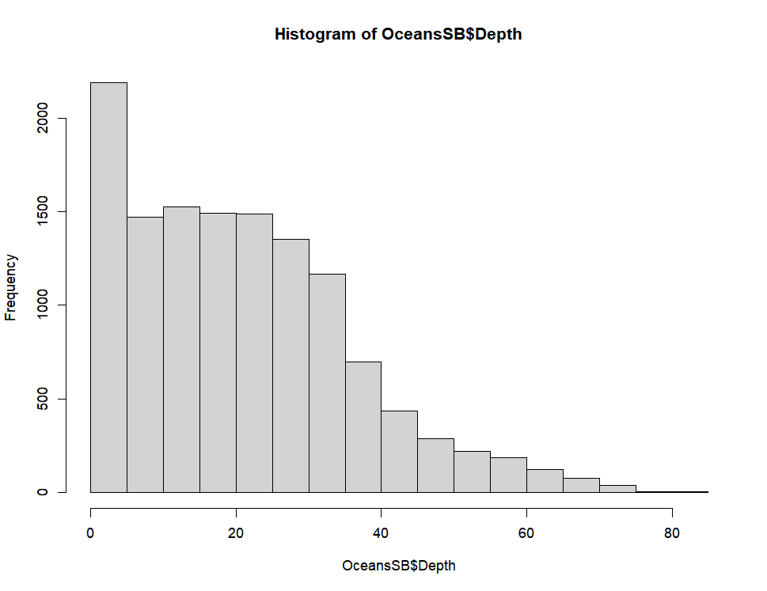
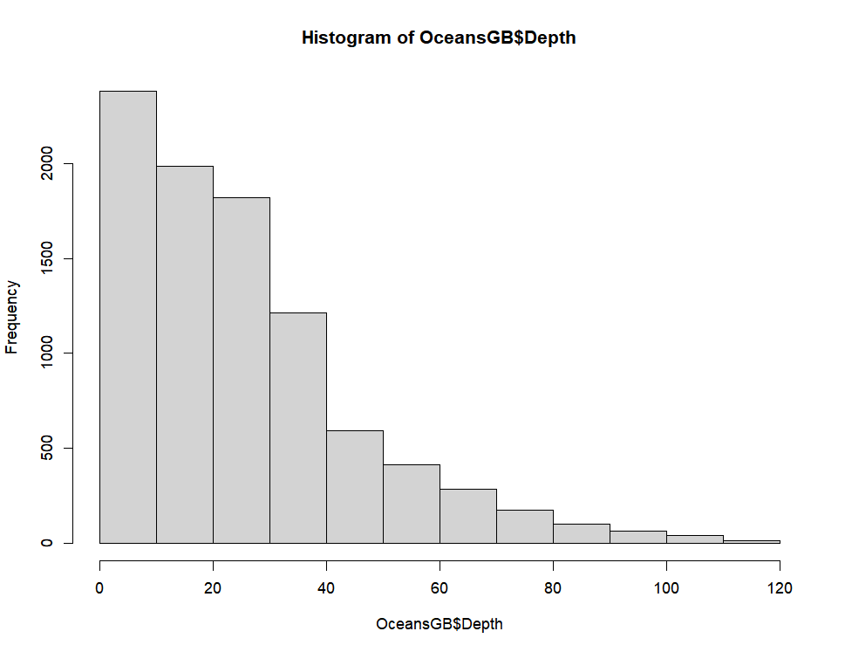
Sample Depth Distributions

Slide 7
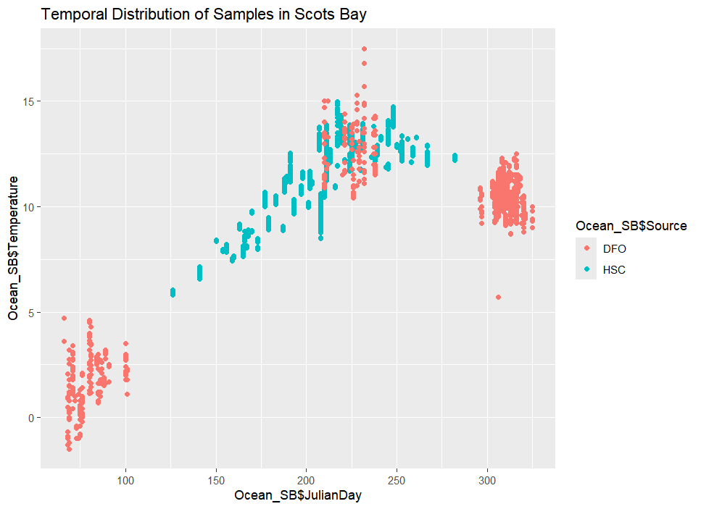
Scots Bay Temporal Spread – All Data

Slide 8
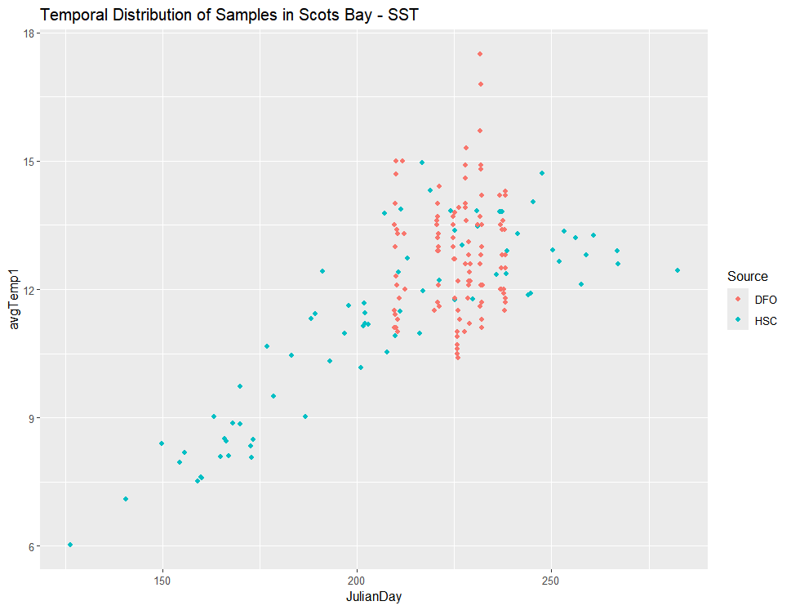
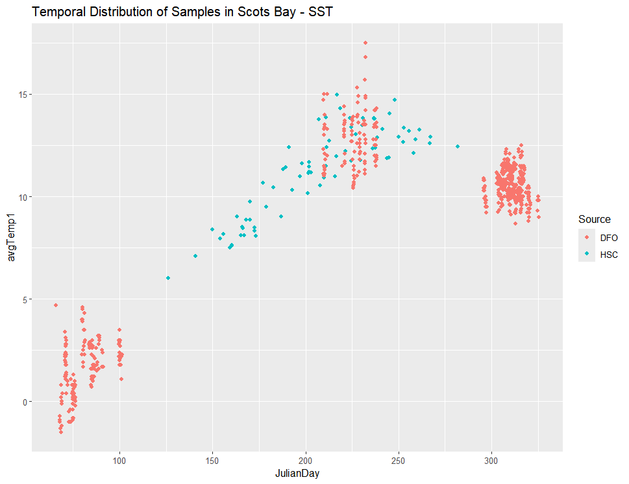
SST – Scots Bay
Remove the fall and winter DFO recordings

Slide 9
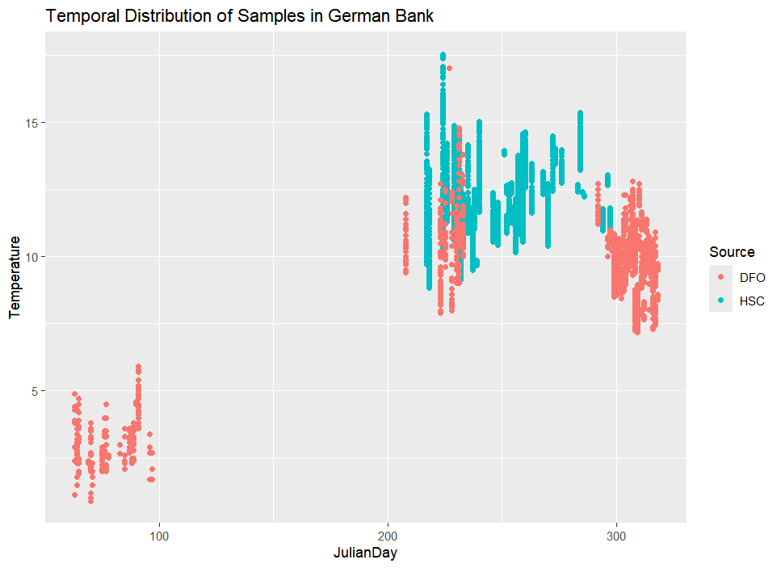
German Bank Temporal Spread All depths and measurements

Slide 10
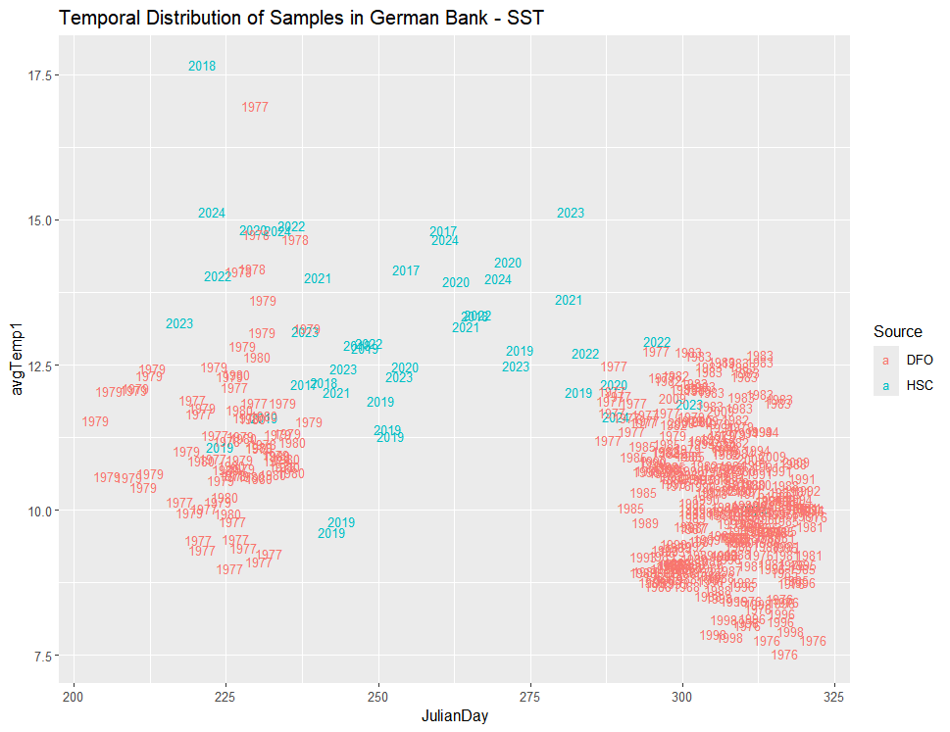
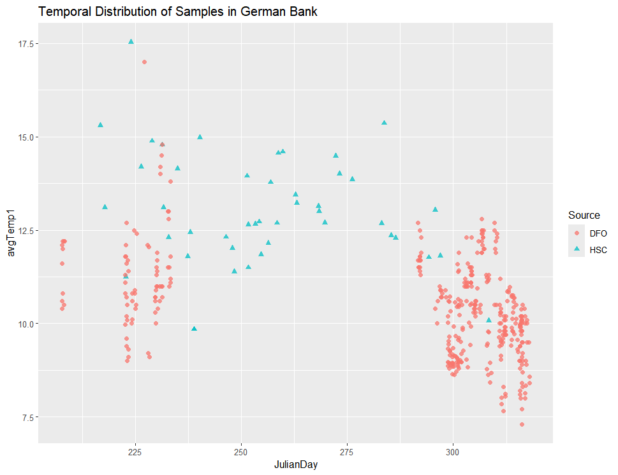
Remove the data from Winter - SST
How do you suggest I run the analysis?

Slide 11
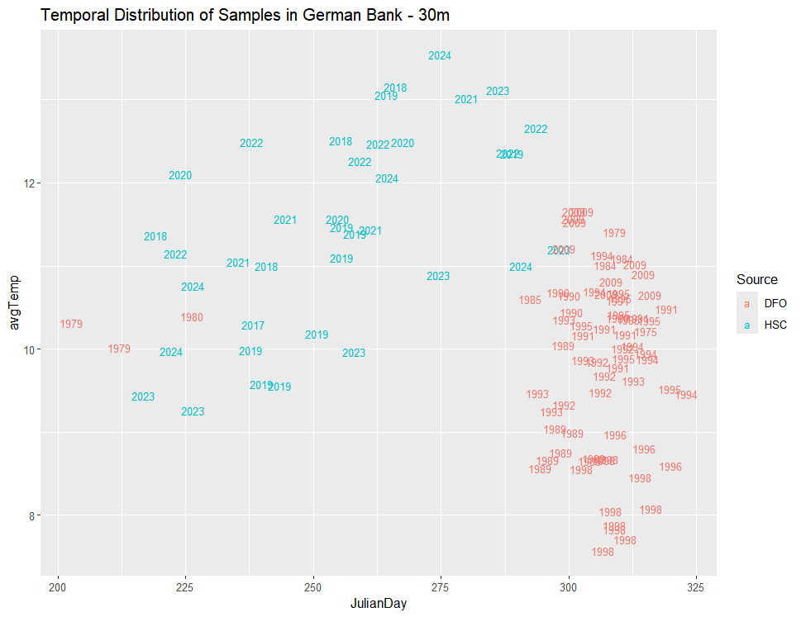
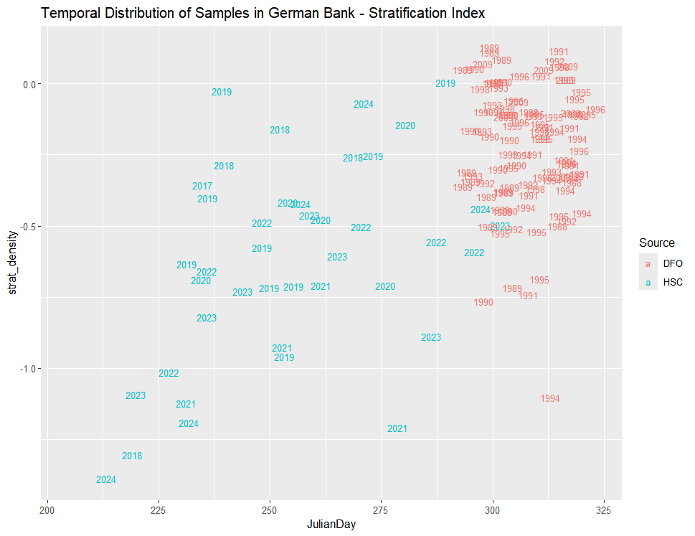
At Depth, fewer samples from DFO
Can I run any at depth comparisons?
Stratification Index quite mismatched temporally

Slide 12
AI
Process | Typical Julian‑day tolerance
Surface temperature | ±10–15 days
Mixed layer depth | ±10 days
Stratification / density structure | ±10–20 days
Bottom water properties | ±15–30 days
Shelf systems (high variability) | narrower windows preferred
Common Defensible Approaches:
A fixed seasonal window, i.e. Summer = Julian days 180-240
Rolling window around a target day, i.e. Target day = 220, Window = ±15 days (finer temporal scale)
Seasonal climatology and anomalies, i.e. Compute seasonal means, subtract it, compare anomalies

